Slide 1
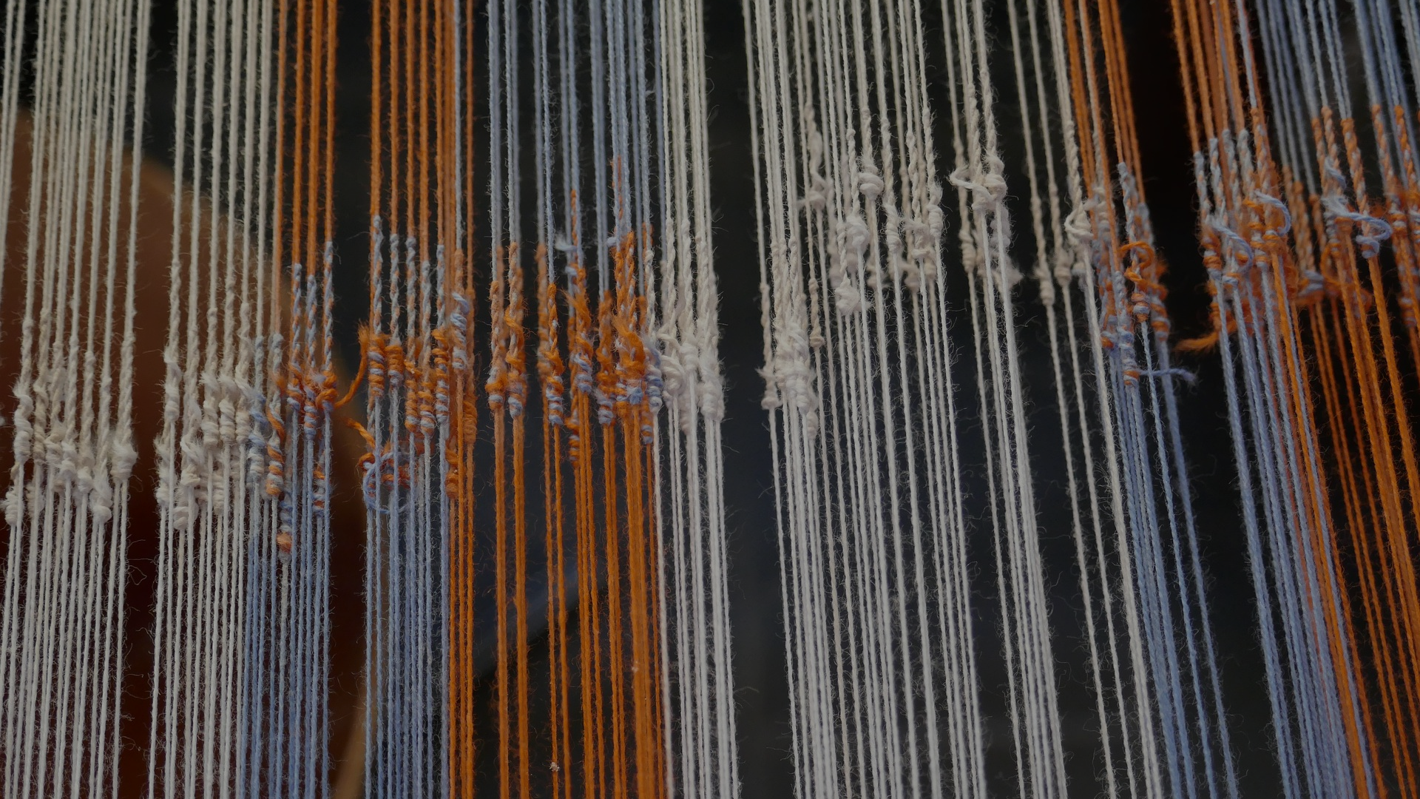
SEEING WHAT WE WANT TO SEE
BQ3 Spin Lesson 9
I can explain how confirmation bias can cause us to misinterpret and misrepresent the world
Notes:
See how this lesson links to the course by viewing the final slide
Key TOK terms appear in a red font
Note that we develop the ideas in this lesson even further in 6.9 - The necessity of humility

Slide 2
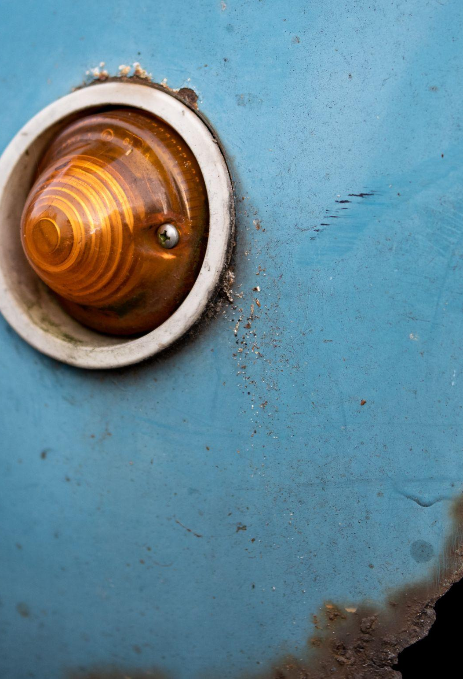
Starter
“Once you have built up a perception of the world, you will ignore any information to the contrary… changing the way that you think is going to be quite cognitively costly.”
(Hannah Critchlow)
What do you think Critchlow meant, and what are the implications of her point?
Notes:
Definitely worth discussing at length.
It’s much easier to confirm, rather than challenge our own beliefs and ideas.
This means that it’s quite rare to find knowers who are receptive to anything that clashes with their own worldview and outlook.
This makes it harder to reach consensus on things, and harder to develop our understanding of the world.
Read an interview with Hannah Critchlow here.

Slide 3
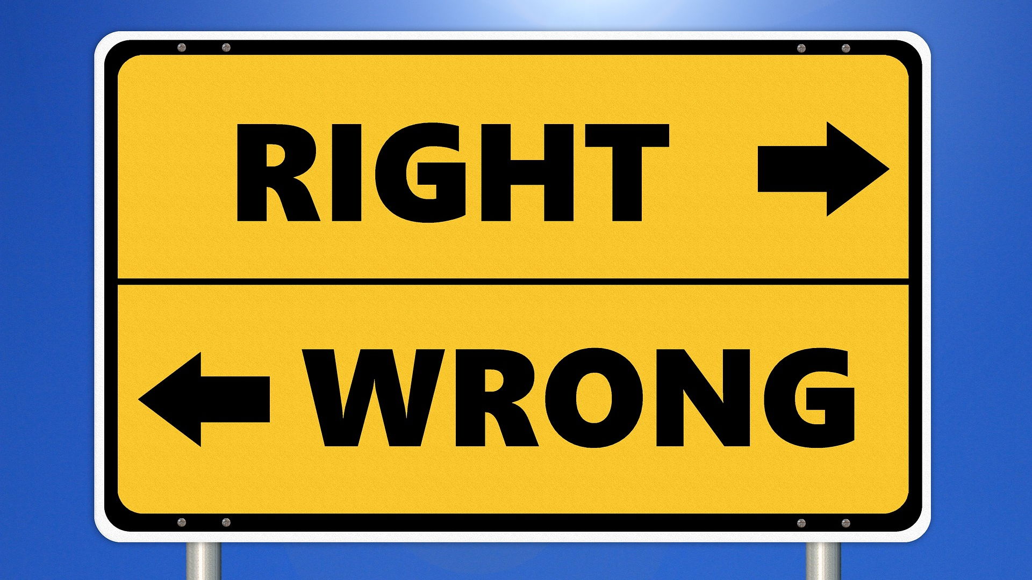
Self-reflection
How willing are you to admit that you may be wrong?
When was the last time you changed your opinion or belief about something?
Notes:
Push the students here - really try to get them to be honest about this question.
The teacher could model their own level of openness to other viewpoints and outlooks, with examples of how they have changed their mind over time.

Slide 4
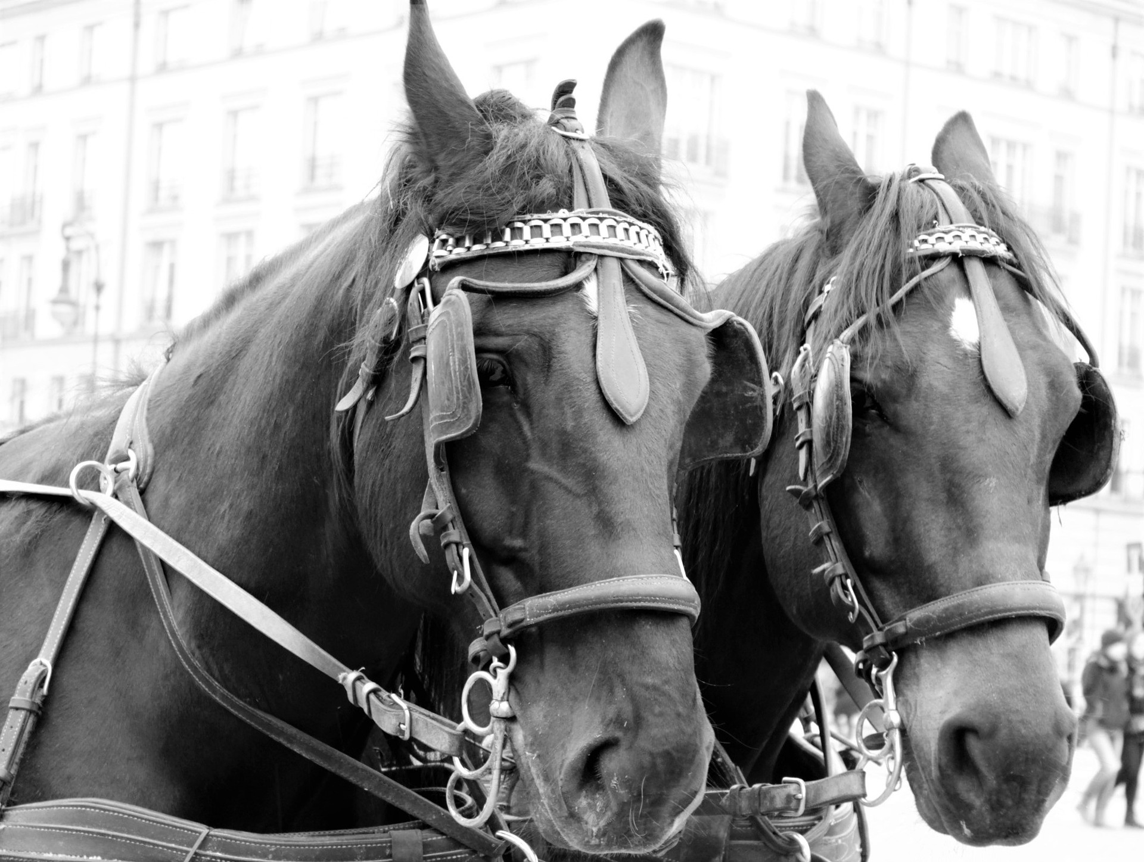
Confirmation bias
We mentioned ‘confirmation bias’ during our first ever task - on critical thinking.
What do you remember about this term?
How does confirmation bias impact on the way we interpret and explain the world (in other words, why the picture of the horses!)?
Notes:
See lesson 1.1.
They are, obviously, blinkered - which is what can happen if we refuse to challenge our own beliefs and opinions, and be dogmatic about how we view the world.

Slide 5
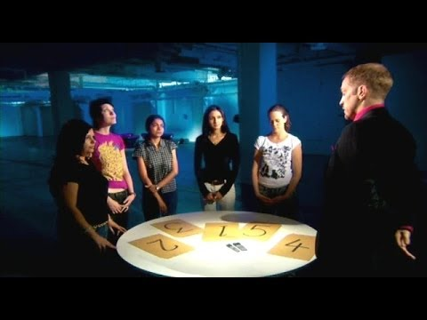
Cold reading
What can we learn about the extent to which people are affected by confirmation bias from the experiment run by Derren Brown?
Why do you think he ran the experiment in three different cultures?
Do you think you would have been convinced by Brown? Be honest!
Notes:
Alternative video link here if this one is not available in your region
More from Derren Brown here on faith healing tricks that only really effective if you believe in faith healing

Slide 6
Exploring the Barnum Effect
Look through the ‘personal’ reading document (similar to the one used by Brown).
How many of the statements could apply to you?
How do you think the extent of your belief of their veracity would change if -
you thought this ‘reading’ had been designed specifically for you?
you were a ‘believer’ in this way of producing knowledge?
Notes:
Personal reading is here.
This is taken from Forer’s personality test, which can be explored, starting here (and used to give students an explanation of the term ‘Barnum Effect’)

Slide 7
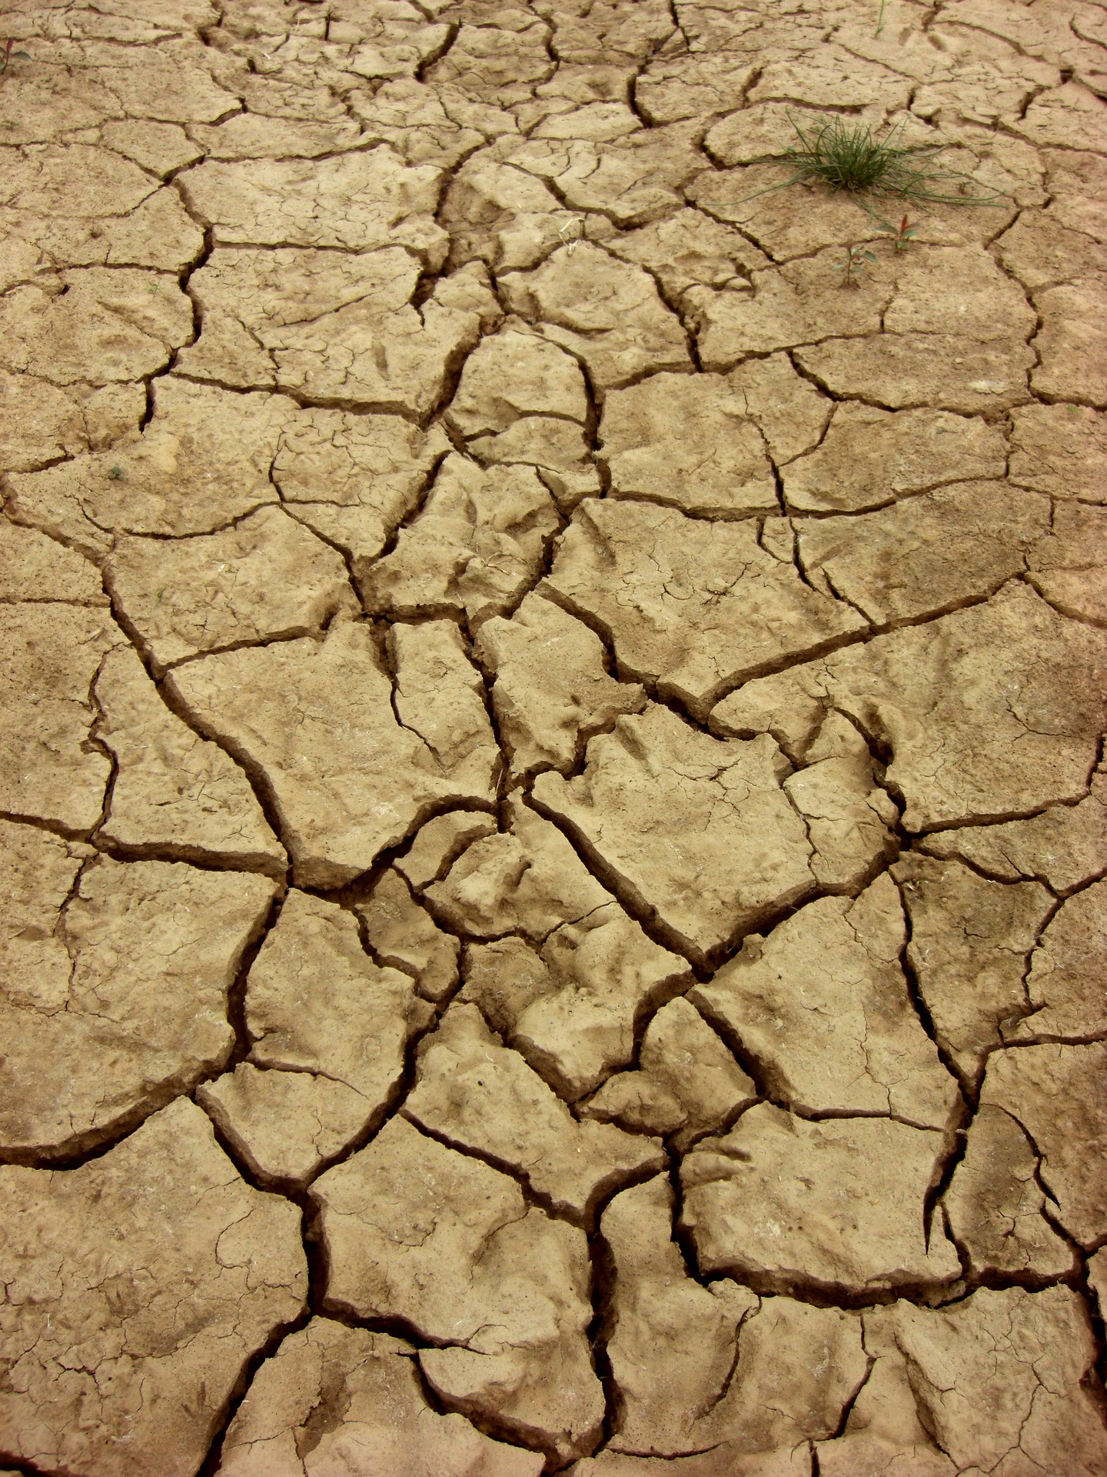
Confirmation bias and scientific knowledge
Read the Conversation article on communicating scientific ideas. Explain the following statements:
Paragraph 4: “just knowing facts doesn’t necessarily guarantee that one’s opinions and behaviors will be consistent with them.”
Paragraph 12: “Those who initially opposed the idea of human-caused global warming became even less accepting after reading about the scientific consensus on the issue.”
Paragraph 21: “The words we use to package our ideas can drastically influence how people think about those ideas.”
Notes:
Article is here.
Responses could be presented on large paper, within a presentation, or discussed orally.
Note the term ‘framing’ for the answer to the last question.

Slide 8
Links to the TOK exhibition
Related exhibition prompt How might the context in which knowledge is presented influence whether it is accepted or rejected (IAP-24)?
Refer to the ideas from this lesson to answer this question.
For example, think about what kind of context might persuade you to believe or reject something - particularly if you were biased towards it already.
Which objects could help to illustrate your answer?
Notes:
Optional slide, if you want to help students to take ownership of the IA prompts (IAPs) for the TOK exhibition

Slide 9
How does confirmation bias cause us to misinterpret and misunderstand representations of the world? How serious can the implications of this be?
Notes:
In other words, which beliefs and opinions and affiliations do students seek only to confirm, rather than challenge?
Or, how open minded are they?
Encourage students to offer opinions on the related exhibition prompt, and think of an object from this lesson to link to it.
In terms of the implications - the greatest threat facing the planet right now (climate change) may defeat us because of many people’s inability to get beyond their confirmation bias, and view the data (and listen to the experts) objectively.
See the BQ3 assessment tracker for suggestions on providing feedback, and recording students’ progress

Slide 10
Linking this lesson to the course
During this lesson, we consider the highlighted aspects of the TOK course
The images used in the presentation slides can also give students ideas about selecting exhibition objects; see also our link below to a specific IA prompt
CORE THEME | OPTIONAL THEMES | AREAS OF KNOWLEDGE | TOK ASSESSMENT
Knowledge & the knower | Indigenous societies | The arts | The TOK essay
 | Language | History
 | Politics | The human sciences | The TOK exhibition Could be linked to IAP-3 (bias), and IAP-24 (context)
 | Religion | Mathematics
 | Technology | The natural sciences

Slide 11
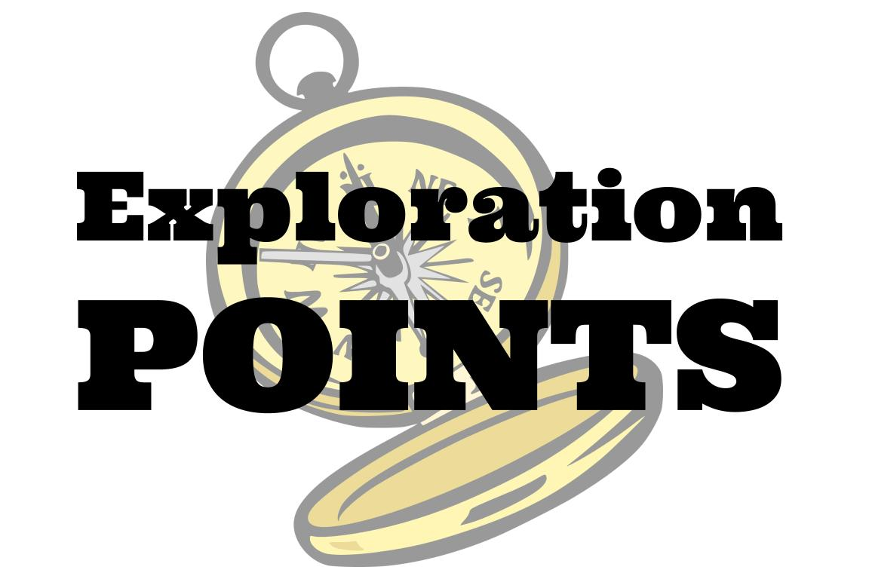
Explore the TOK themes and areas of knowledge in more depth via a range of thinkers, media sources, and other resources, in our EXPLORATION POINTS DOCUMENTS.
Access the documents via the links below. You’ll also find the EP icons on all of the TOK course pages of the site to help you unpack the quotes, KQs, and real-life situations that you find there.
CORE THEME
Knowledge & the knower
OPTIONAL THEMES
Indigenous societies
Language
Politics
Religion
Technology
AREAS OF KNOWLEDGE
The arts
History
Human sciences
Mathematics
Natural sciences
Notes:
Use this slide to access the ‘Exploration Points’ notes for BQ3, which will help students to develop a deeper knowledge of any TOK theme or area of knowledge. This will not only help them to master the TOK course in general, but also craft a great exhibition or essay.
Be ready to provide more guidance on how to use this resource - ie, which media sources to focus on, which questions to address, which TED talks to watch, and which key terms and ideas to understand.

